Slide 1
RESTAURANT BILLING SYSTEM
Submitted By:
Shubhankar Mehrotra (RA1711003030109)

Slide 2
INTRODUCTION
This simple Restaurant Billing System project is written in Python. The project file contains a python script (Restuarant.py). This is a simple GUI based application which is very easy to understand and use. It uses Tkinter module for the GUI. Talking about the application, the user just has to select among the food and drinks items, enter the quantity and click on the total button to view the total price. This simple application also displays the total prices of each item without any tax and extra charges.
The user can view the total receipt of their items which displays receipt number and number of their food/drinks items with the total amount. Here, the total bill of the customer includes tax and service charges too. The design is so simple that the user won’t find any difficulties while working on it.

Slide 3
TOOLS USED
Python 3.7, Visual Python, Anaconda have been used to develop this Restaurant Billing program for designing and developing this program. Python is a widely used high-level programming language for general-purpose programming, created by Guido van Rossum and first released in 1991.
An interpreted language, Python has a design philosophy that emphasizes code readability (notably using whitespace indentation to delimit code blocks rather than curly brackets or keywords), and a syntax that allows programmers to express concepts in fewer lines of code than might be used in languages such as C++ or Java. The language provides constructs intended to enable writing clear programs on both a small and large scale

Slide 4
Features of Restaurant Billing System
SIMPLE MENU SETUP
TRACKING OF SALES AND TAXES
USER FRIENDLY ORDER MANAGEMENT
INVENTORY CONTROL
COMPREHENSIVE REPORTING AND CUSTOMER DATA

Slide 5
Work Done by Team Members
I have done syntax and sematic part of the code which included the gui part also .
My group member (Shubhankar)has done the logical part of the code which included the billing calculator , item lists, item calculator and many more.

Slide 6
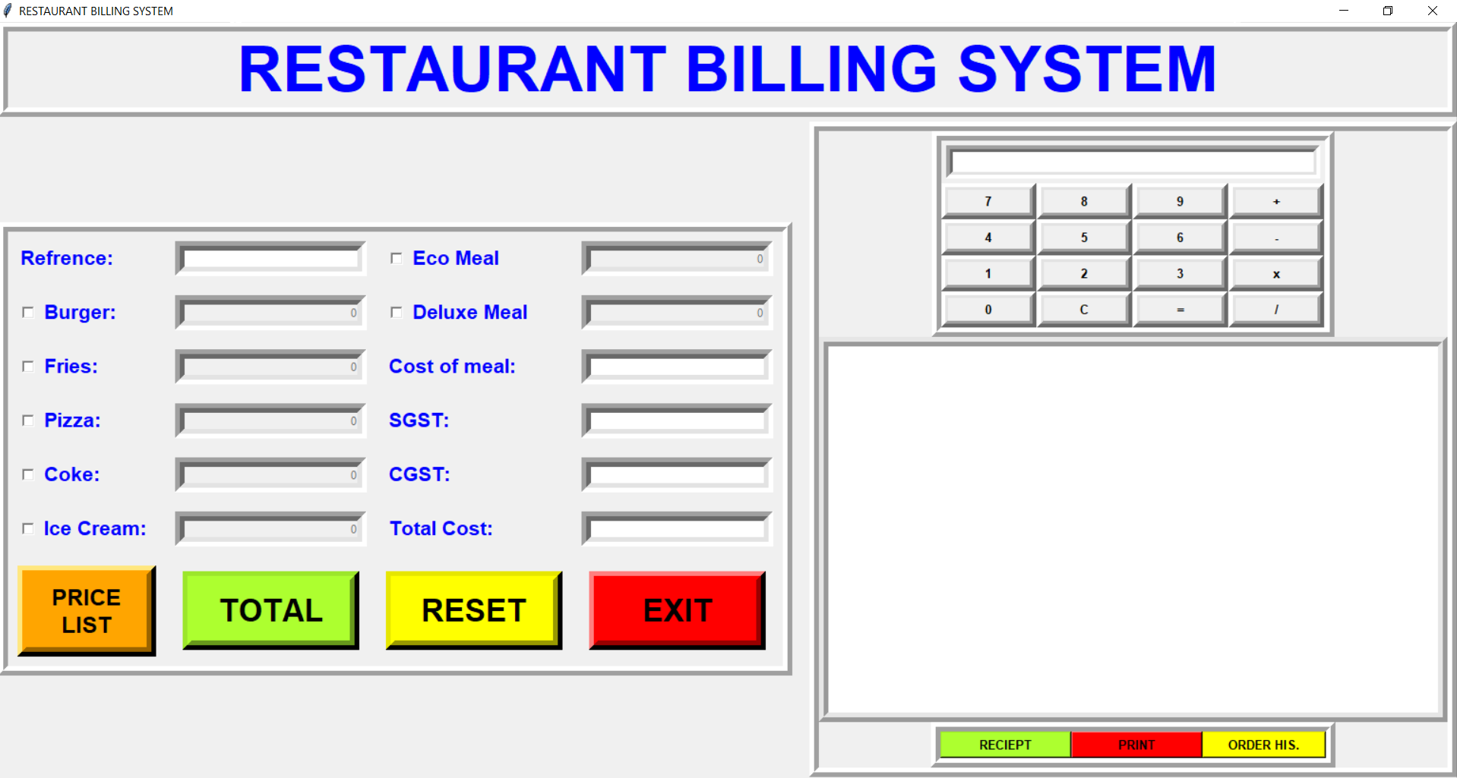
Screenshots of the Project
GUI – Main display window with name of restaurant name current time and date with calculator

Slide 7
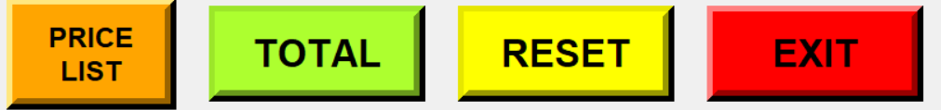

Buttons –
These Buttons shows the price list, total amount, rest , receipt of food ,print ,order
highlights and exit .

Slide 8
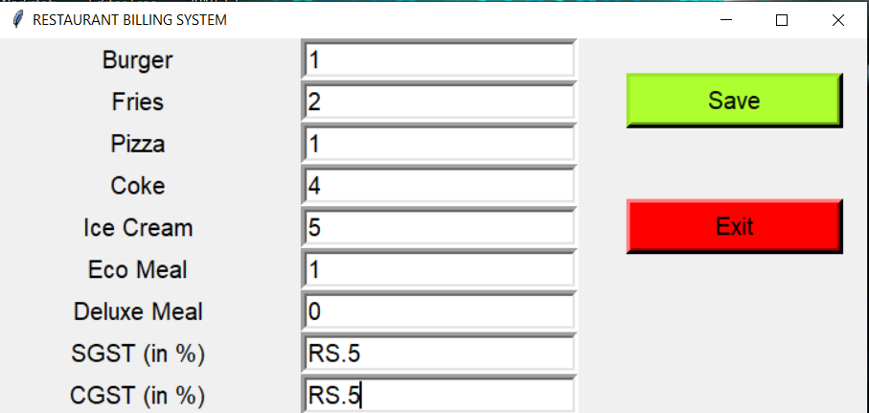
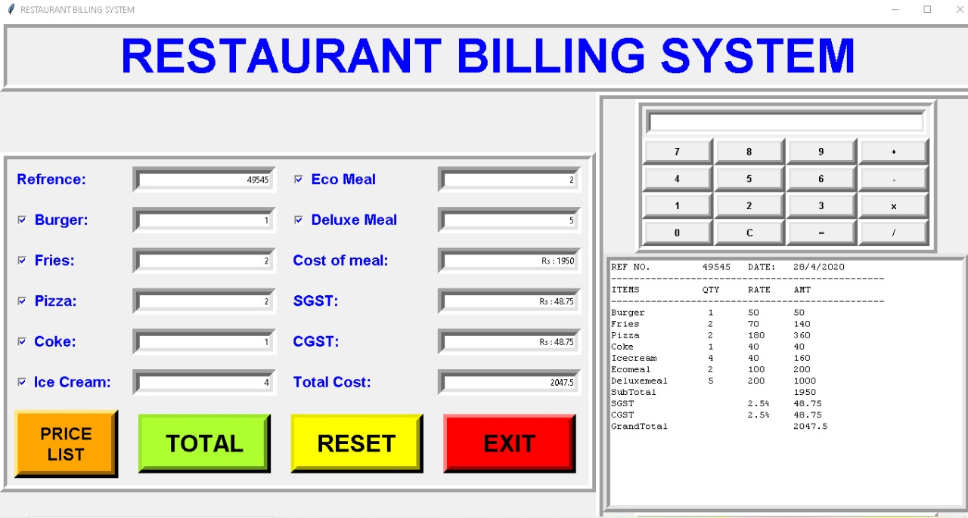
We need to insert number of menu items taken by customer ,after inserting no. of items.
After clicking TOTAL button it will automatically generate the bill

Slide 9
Advantages of Restaurant Billing System
Restaurant Management Software
Workforce Management
Inventory Control
Tracking of Sales
Credit and Debit Card Processing
Preparation of Financial Statements
Point of Sale Security
Off-site Control

Slide 10
Conclusion
This project has really been faithful and informative. It has made us learn and understand the many trivial concepts of Python Language. As we have used python Tkinter as a GUI it provides various controls, such as buttons, labels and text boxes to build a user friendly application.
The fast growing use of internet confirms the good future and scope of the proposed project.
Finally it has taught us a valuable lifelong lesson about the improvements and working and interacting in a group.

Slide 11
Thank You

